Slide 1
Face Detection
with the Modified Census Transform
Bernhard Froba & Andreas Ernst
6th IEEE International Conference
On Automatic Face and Gesture Recognition ‘04

Slide 2
Contents
1. MCT Feature Generation
2. Training and Classification
3. Experiment and Result

Slide 3
What is the MCT?

Slide 4

Local Structure Features
2⁸ | 2⁷ | 2⁶
2⁵ | 2⁴ | 2³
2² | 2¹ | 2⁰
56

Slide 5
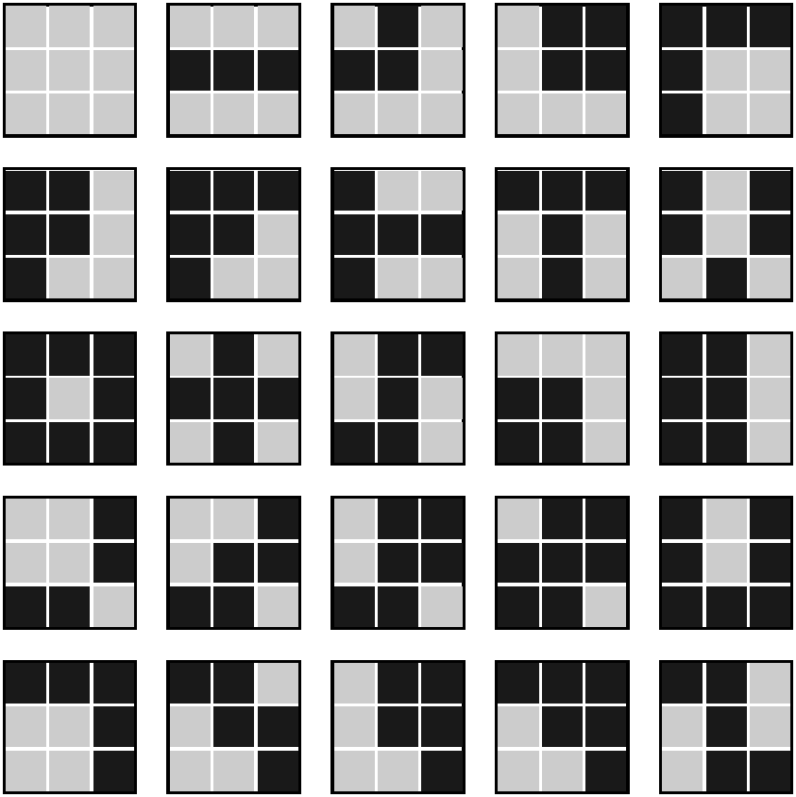
Local Structure Features
0 | 56 | 176 | 216 | 484
436 | 500 | 316 | 466 | 362
495 | 186 | 214 | 54 | 438
78 | 94 | 222 | 254 | 367
457 | 409 | 217 | 473 | 403
2⁹ = 512
kernels
0 ~ 511
Kernel indexs

Slide 6
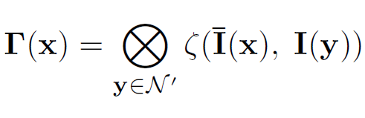





The modified Census Transform
Concatenation operation
A comparison function be 1 if
A local spatial neighborhood of the pixel at x
The intensity mean on this neighborhood

Slide 7
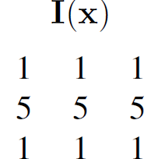
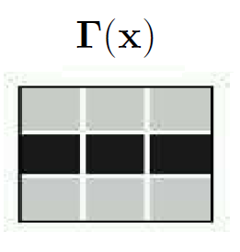

The modified Census Transform
56

Slide 8
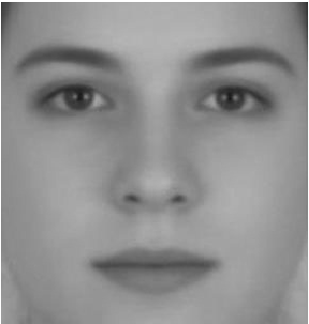
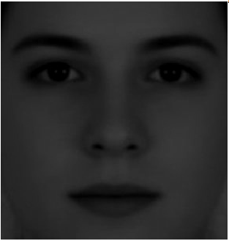
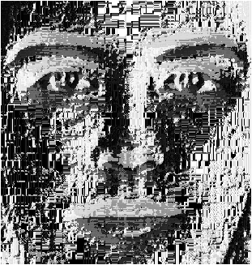
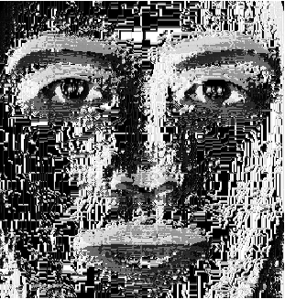
illumination invariant of MCT

Slide 9
How is the classifier designed?

Slide 10
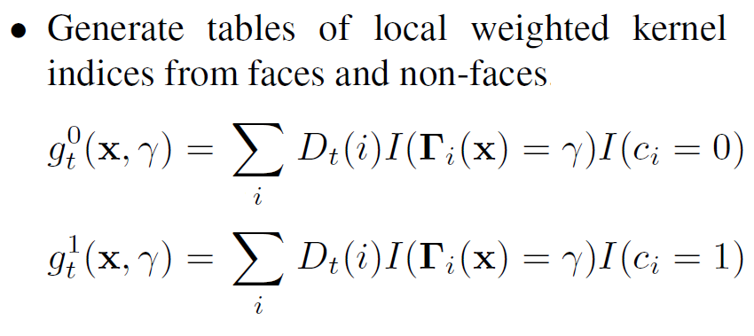
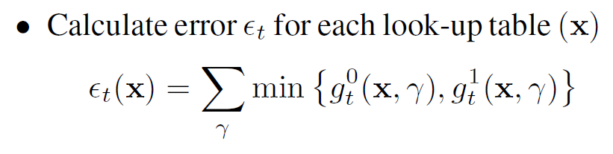
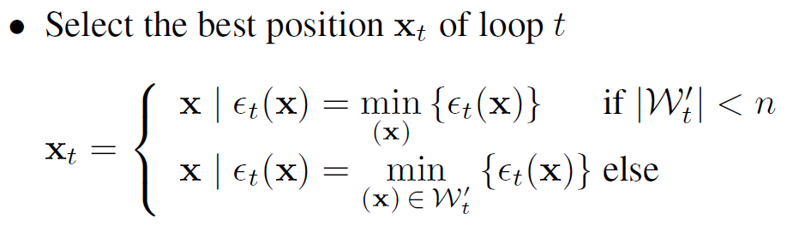
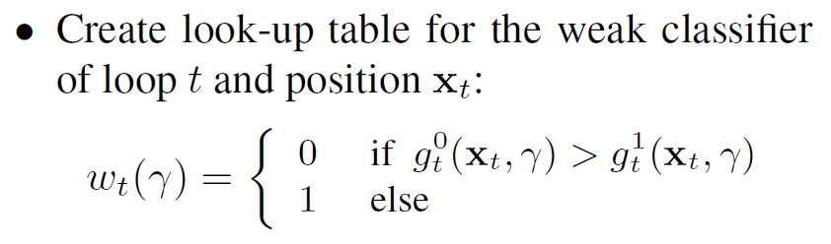
…
0
1
2
3
4
5
6
7
8
0
1
2
3
4
5
6
7
8
…
…

Slide 11
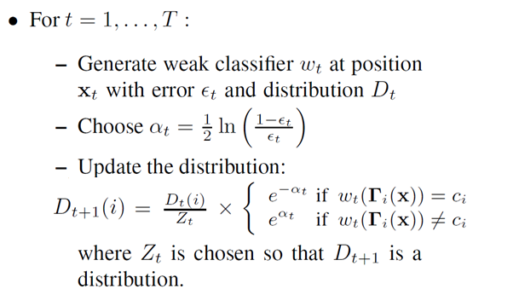
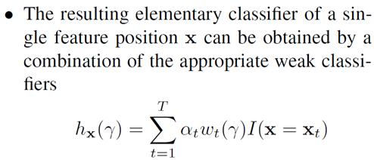
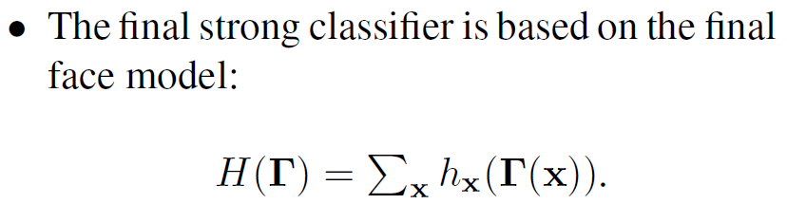
0
1
2
3
4
5
6
7
8
…

Slide 12
How is the result?

Slide 13
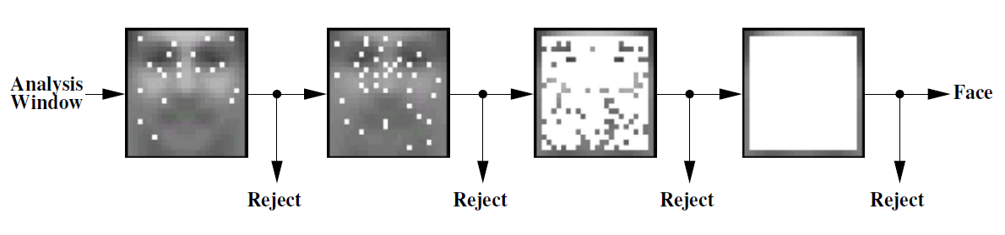
Experiment
Features
20
40
400
484
First stage rejects over 99% of all background locations

Slide 14
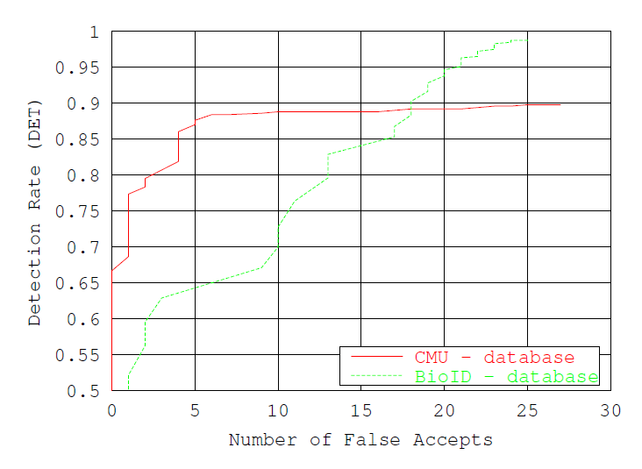
Result
False Positive Rate
1.3×10⁻⁷%
CMU+MIT : 483 upright faces / 80×10⁶ analysis windows
BioID : 1522 frontal faces / 355×10⁶ analysis windows

Slide 15
Thank you.

